Slide 1






Online Retail Revenue
& Customer Behavior Analysis
Data-Driven Insights for Business Growth
Revenue Analytics
Customer Segmentation
Churn Prediction
Strategic Recommendations

Slide 2








Executive Summary
£8.91M
18,532
£481
4,372
Total Revenue
Total Orders
Avg Order Value
Identified Customers
Transactional data analysis & cleaning
UK dominance: 82% revenue share
RFM customer segmentation
Q4 seasonality: Peak in Nov-Dec
Churn prediction modeling (ML)
Retention: 65.6% repeat customers
Power BI business dashboard
4 customer segments identified

Slide 3
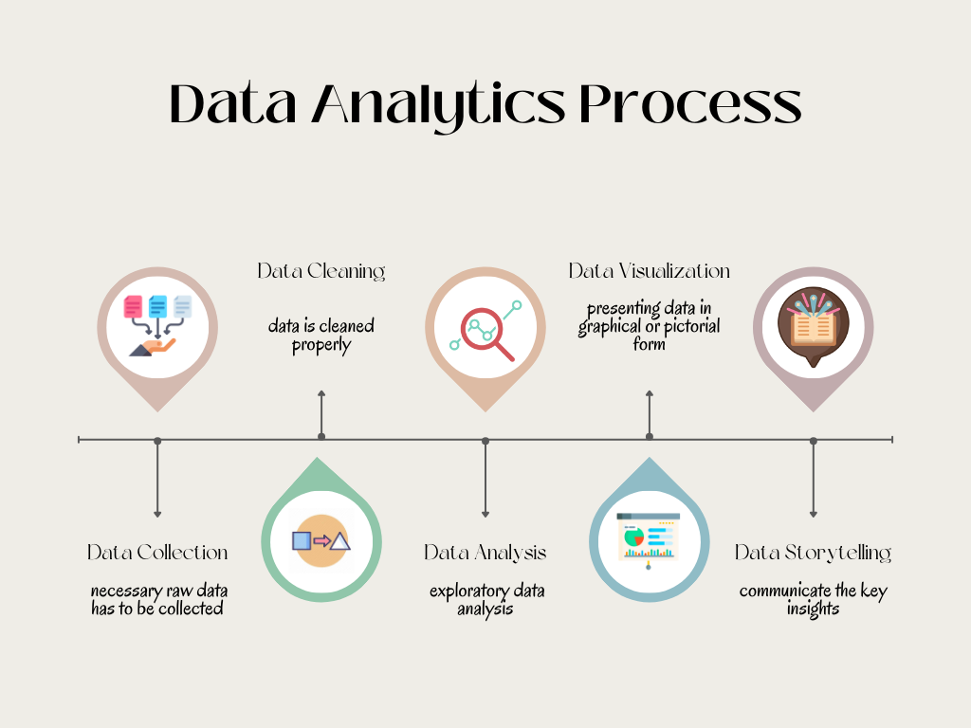




Project Methodology
Data Auditing & Cleaning
2
Insight Extraction
1
SQL (SQLite)
Python
Revenue KPIs & trends
Remove duplicate rows
Product performance
Handle cancellations
Country-level analysis
Quality flag processing
Customer Segmentation
Business Intelligence
3
4
RFM Modeling
Power BI Dashboard
Recency analysis
Interactive visualization
Frequency scoring
Monetary evaluation
KPI tracking
Slicer-based filtering

Slide 4





Data Quality & Dataset Overview
25,900
4,372
5,268
All valid sales for trends & products
Unique Invoices
Identified Customers
Duplicate Rows
Identified customers only for RFM
Cancellation Rows (C)
9,288
CustomerID ≠ null
InvoiceNo ≠ 'C'
Negative/Zero Qty
10,624
2,517
Quantity > 0
UnitPrice > 0
Non-Positive Price

Slide 5






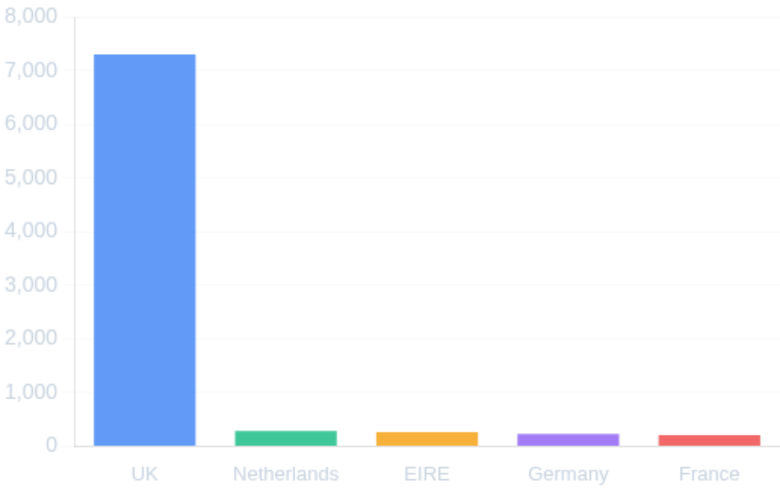
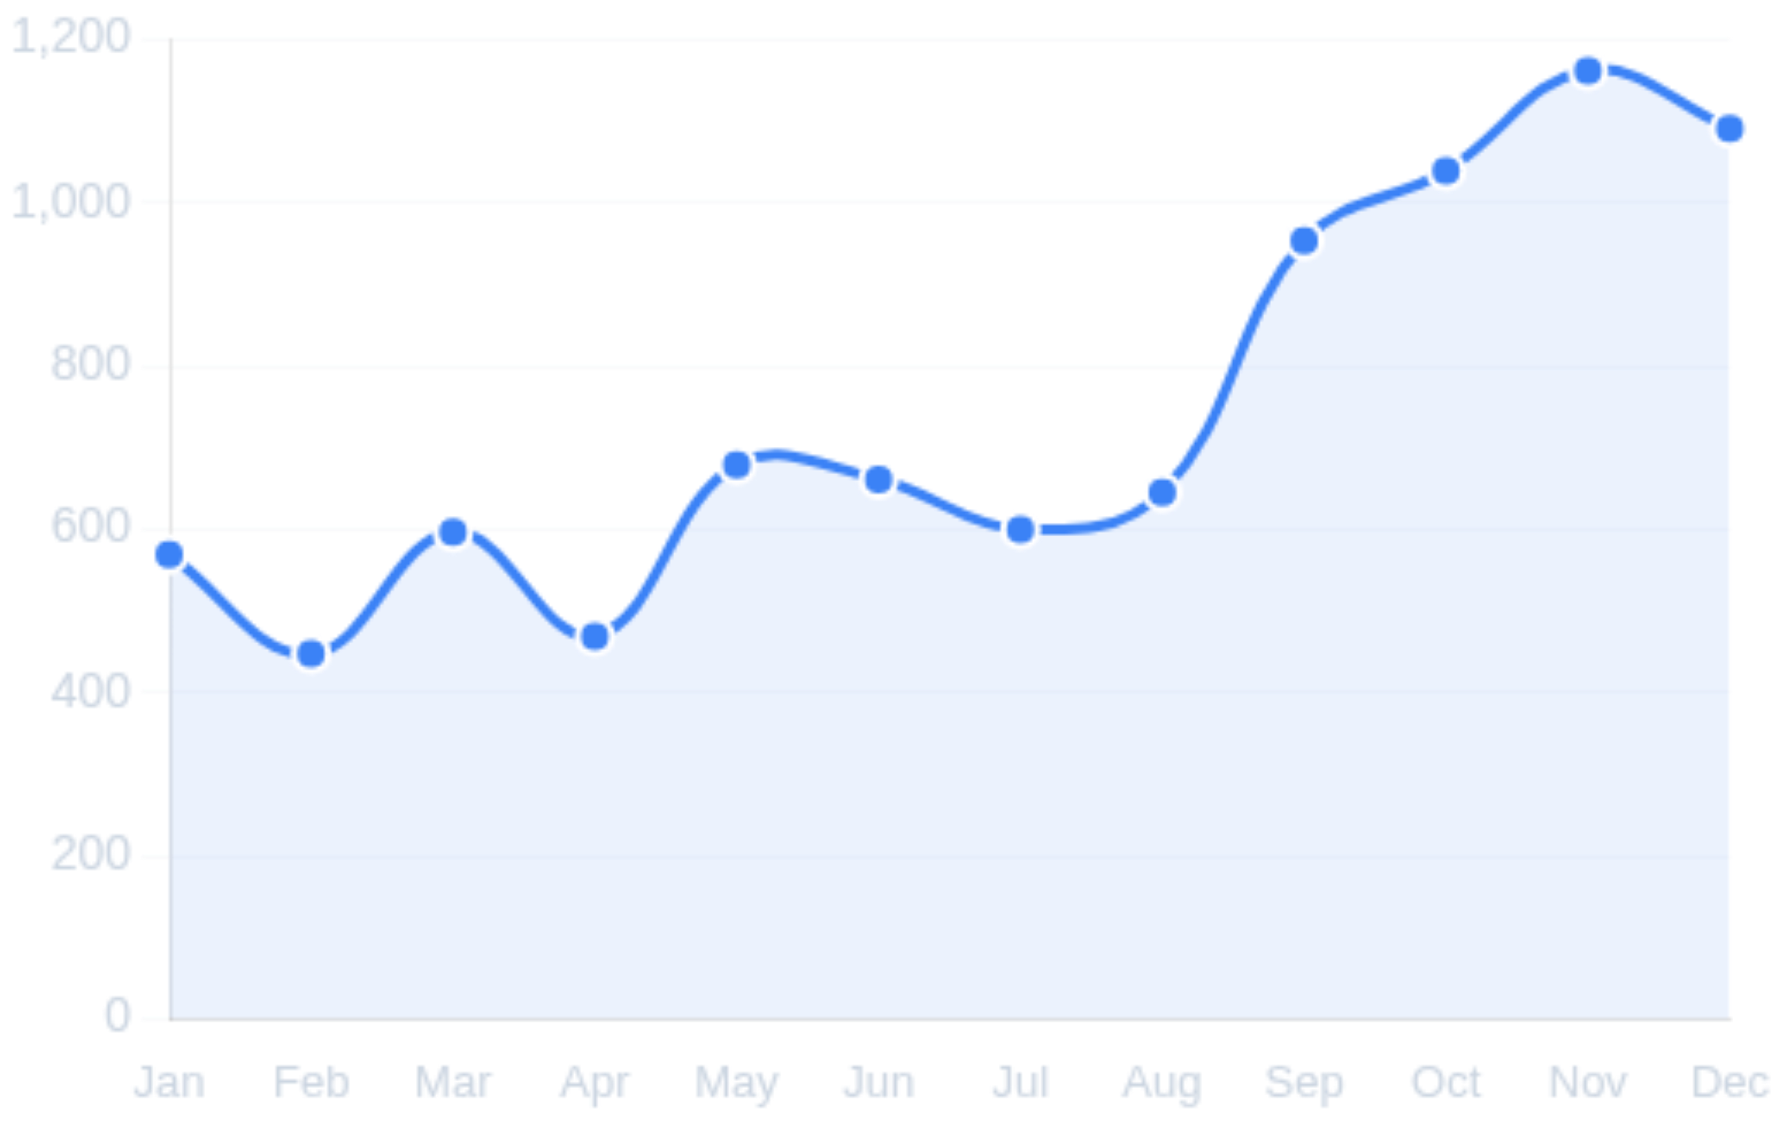
Revenue Performance Dashboard
£8.91M
18,532
£481
82%
Total Revenue
Total Orders
Avg Order Value
UK Revenue Share

Slide 6









Revenue Deep Dive
Paper Craft Little Birdie
£168,470
Singapore
£3,040
Regency Cakestand 3-Tier
£142,593
Netherlands
£3,037
White Hanging Heart
£100,448
Australia
£2,430
Jumbo Bag Red Retrosport
£85,221
Japan
£1,969
Ceramic Storage Jar
£81,417
United Kingdom
£480
High volume, lower average order value
Repeat Purchase
Customer Concentration
65.6%
Repeat Customers
~15%
34.4%
Revenue from Top 10 Customers
Single Purchase

Slide 7
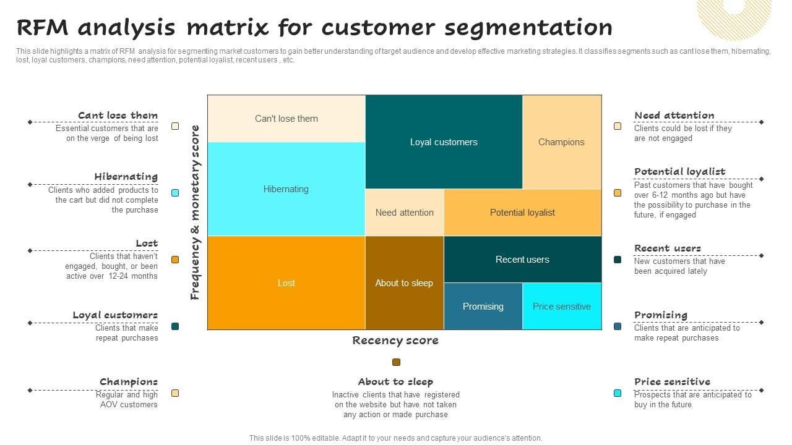








Customer Segmentation - RFM Analysis
14.6%
18.9%
633
5.9
£6,858
820
20.2
£2,440
Customers
Days Recency
Monetary
Customers
Days Recency
Monetary
VIP perks, early access, protect from churn
Cross-sell, upsell, loyalty program nudges
24.6%
42.0%
1,065
217.9
£488
1,820
81.9
£1,126
Customers
Days Recency
Monetary
Customers
Days Recency
Monetary
Win-back campaigns, re-engagement offers
Reminders, personalized offers, increase frequency

Slide 8
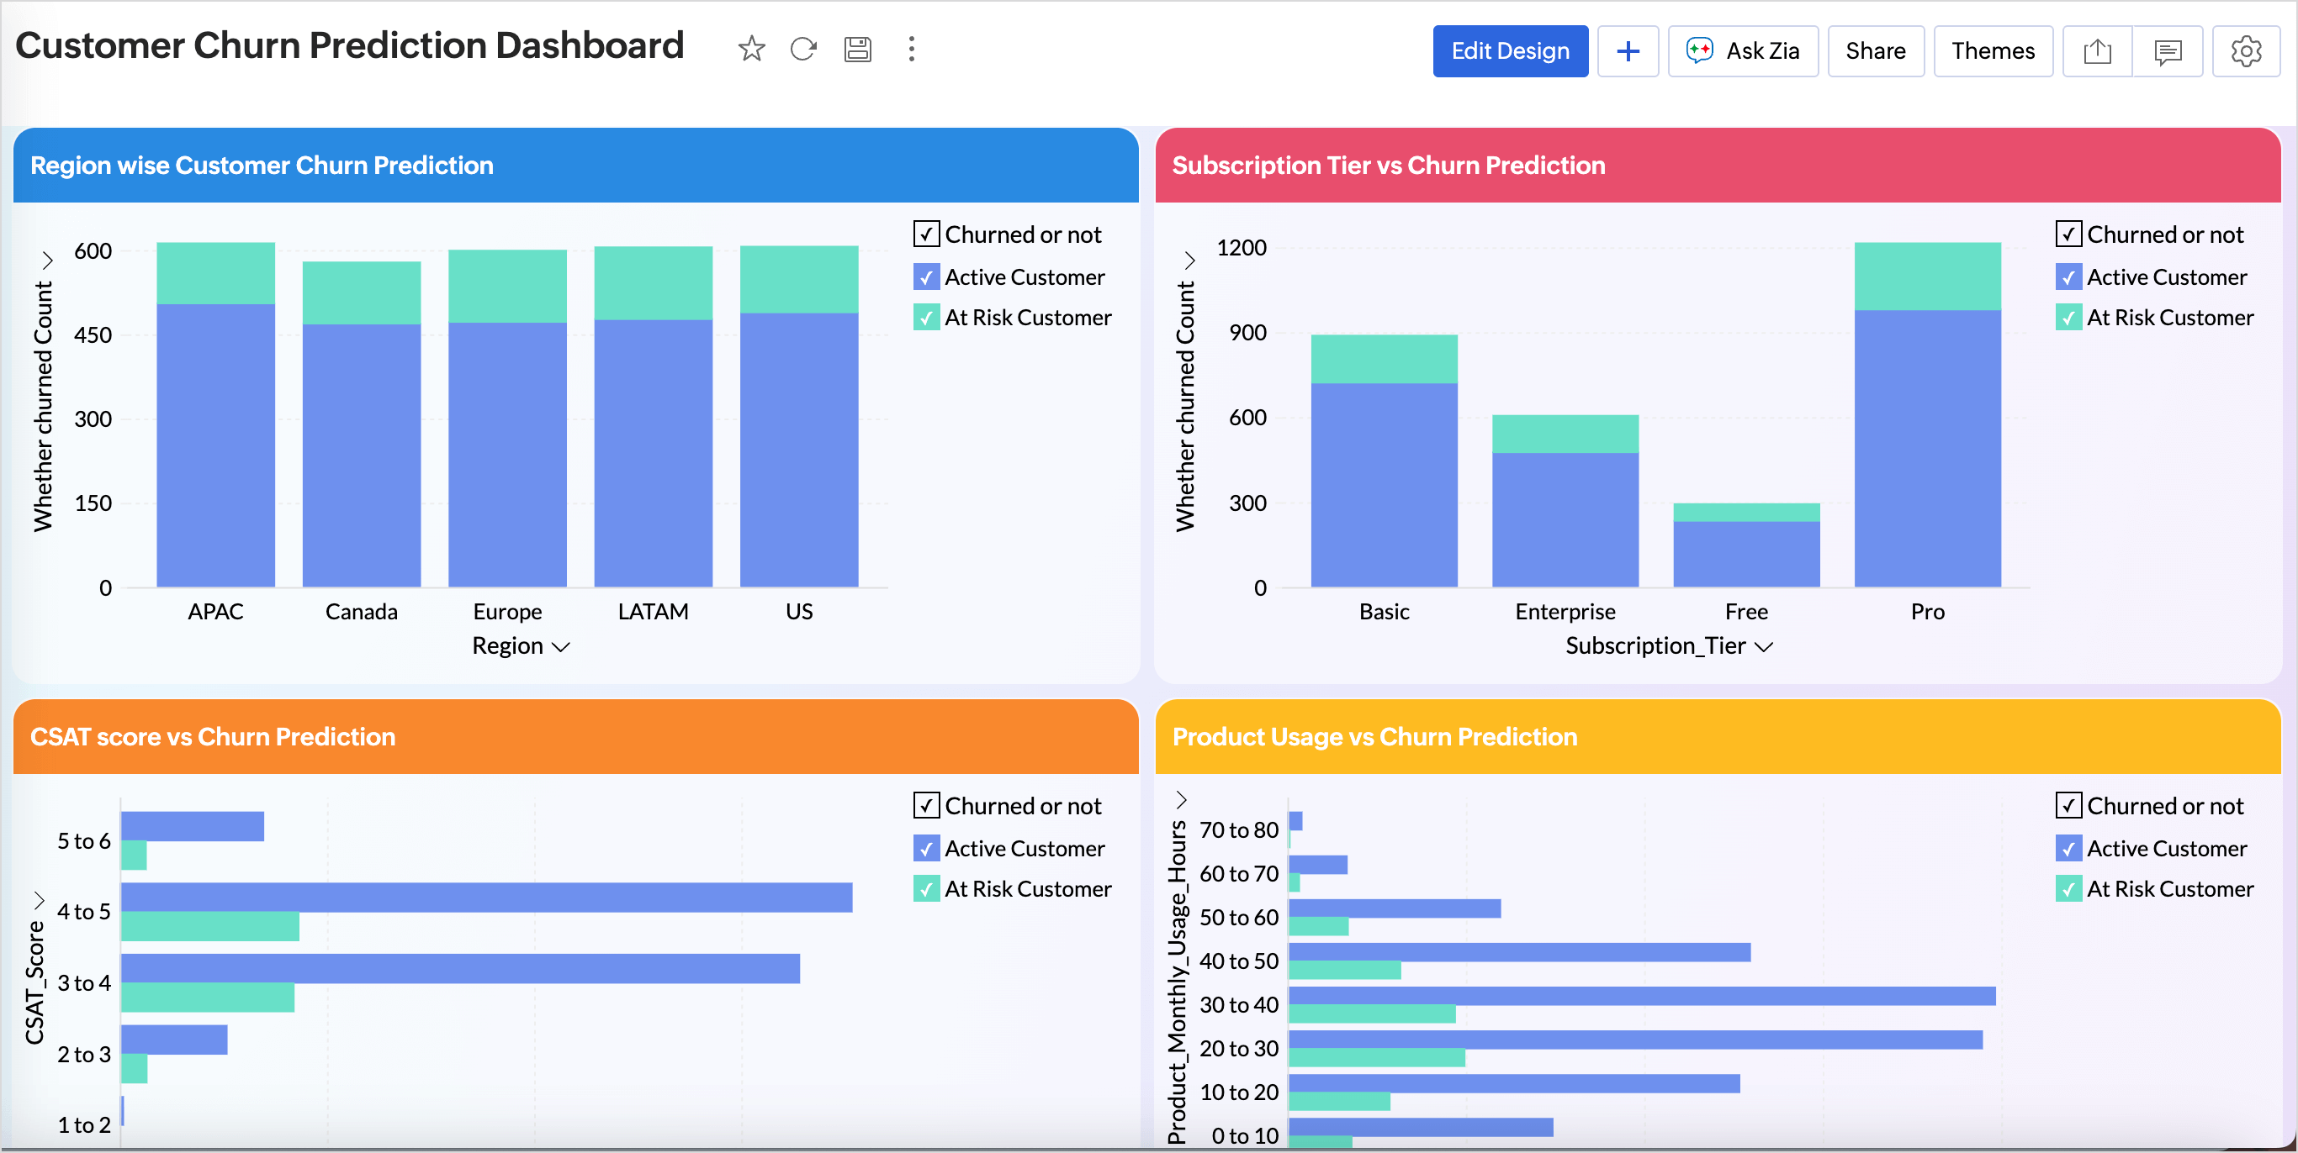







Churn Prediction Modeling
Churn Definition
Approach
No purchase in next 60 days
RFM features from history window
Metric
Accuracy
ROC-AUC
XGBoost
66%
0.721
Metric
Accuracy
ROC-AUC
Random Forest
61%
0.668
Win-back offers for At Risk segment
VIP retention benefits and early access
Data-driven customer targeting

Slide 9







Key Insights Summary
1
2
3
Anonymous Checkout Impact
Strong Q4 Seasonality
Product Revenue Concentration
Revenue peaks in Nov-Dec (£1.16M, £1.09M). Inventory and marketing planning critical
Significant anonymous transactions limit customer analytics and retention capabilities
Top 10 products drive disproportionate revenue. Stockouts risk significant impact
4
5
6
Retention Opportunity
UK/International Dynamics
Clear Customer Segmentation
65.6% repeat customers, but 34.4% one-time buyers. Win-back campaigns essential
UK dominates volume (82%), but international markets show higher average order value
Four distinct segments with actionable strategies for each customer tier
These insights provide a foundation for data-driven decision making and targeted business strategies

Slide 10











Business Recommendations
1
2
3
Identity Capture Improvement
Seasonality Planning
Hero Product Protection
Allocate inventory for Q4
Prevent stockouts
Reduce anonymous checkout
Marketing budget Sep-Dec
Bundle complementary items
Email/account capture
Prepare for peak surge
Lift UK AOV
Enable personalization
4
5
Retention Focus
International Expansion
Win-back At Risk customers (218 days)
Prioritize high-AOV markets
Grow Need Attention segment
Singapore £3,040 • Netherlands £3,037
Targeted offers & campaigns
Tailored shipping & marketing
Implementation of these strategies will drive revenue growth and improve customer retention

Slide 11




Thank You
Ready to transform insights into action
£8.9M Revenue
4 Customer Segments
Revenue opportunity identified
Actionable strategies
Churn Model
Expansion Path
Proactive retention
High-AOV markets
Thank you for your time and attention

